Slide 1
Computer Architecture and Organization

Slide 2
Outline
Functional units of a computer
History of Computers
Architecture & organization
Organization of the von Neumann machine
Fetch and Execute Cycle – Intro

Slide 3
Module 1:
Module:1 Introduction to computer architecture and organization.
Overview of Organization and Architecture –Functional components of a computer: Registers and register files - Interconnection of components - Overview of IAS computer function - Organization of the von Neumann machine - Harvard architecture - CISC & RISC Architectures

Slide 4
What is a computer?
a computer is a sophisticated electronic calculating machine that:
  Accepts input information,
  Processes the information according to a list of internally stored instructions and
  Produces the resulting output information.
Functions performed by a computer are:
  Accepting information to be processed as input.
  Storing a list of instructions to process the information.
  Processing the information according to the list of instructions.
  Providing the results of the processing as output.
What are the functional units of a computer?

Slide 5
Functional units of a computer
Input unit accepts
information:
Human operators,
Electromechanical devices (keyboard)
Other computers
Arithmetic and logic unit(ALU):
Performs the desired
operations on the input
information as determined
by instructions in the memory
Memory
Arithmetic
& Logic
Input
Instr1
Instr2
Instr3
Data1
Data2
Output
Control
I/O
Stores
information:
Instructions,
Data
Processor
Control unit coordinates
various actions
Input,
Output
Processing
Output unit sends
results of processing:
To a monitor display,
To a printer

Slide 6
Information in a computer -- Instructions
Instructions specify commands to:
  Transfer information within a computer (e.g., from memory to ALU)
  Transfer of information between the computer and I/O devices (e.g., from keyboard to computer, or computer to printer)
  Perform arithmetic and logic operations (e.g., Add two numbers, Perform a logical AND).
A sequence of instructions to perform a task is called a program, which is stored in the memory.
Processor fetches instructions that make up a program from the memory and performs the operations stated in those instructions.
What do the instructions operate upon?

Slide 7
Information in a computer -- Data
Data are the “operands” upon which instructions operate.
Data could be:
  Numbers,
  Encoded characters.
Data, in a broad sense means any digital information.
Computers use data that is encoded as a string of binary digits called bits.

Slide 8
Memory unit
Memory unit stores instructions and data.
  Recall, data is represented as a series of bits.
  To store data, memory unit thus stores bits.
Processor reads instructions and reads/writes data from/to the memory during the execution of a program.
  In theory, instructions and data could be fetched one bit at a time.
  In practice, a group of bits is fetched at a time.
  Group of bits stored or retrieved at a time is termed as “word”
  Number of bits in a word is termed as the “word length” of a computer.
In order to read/write to and from memory, a processor should know where to look:
  “Address” is associated with each word location.

Slide 9
Memory unit (contd..)
Processor reads/writes to/from memory based on the memory address:
  Access any word location in a short and fixed amount of time based on the address.
  Random Access Memory (RAM) provides fixed access time independent of the location of the word.
  Access time is known as “Memory Access Time”.
Memory and processor have to “communicate” with each other in order to read/write information.
  In order to reduce “communication time”, a small amount of RAM (known as Cache) is tightly coupled with the processor.
Modern computers have three to four levels of RAM units with different speeds and sizes:
  Fastest, smallest known as Cache
  Slowest, largest known as Main memory.
Notes:
Since the instructions and data need to be feteched from the memory in order to perform a task, the time it takes to access and fetch this information will be one factor influencing how fast a given task will complete. In order to increase the speed of performing a task, one way is to reduce the amount of time it takes to fetch the data and the instructions. This time is called as “access time”.
Suppose if we want to fetch the data at memory location with the address 10. In case of sequential access, we have to access locations 1-9, and then access location 10. Clearly, in case of sequential access the access times increase as memory locations with higher access times are accessed. We need some kind of memory which provides fixed and short access time irrespective of the memory location being accessed. That is, it provides random access.
Why is the access time faster for the Cache than it is for primary storage? I haven’t yet discussed how the various units communicate with each other. In a few minutes I will discuss that, and it will become clear.

Slide 10
Memory unit (contd..)
Primary storage of the computer consists of RAM units.
  Fastest, smallest unit is Cache.
  Slowest, largest unit is Main Memory.
Primary storage is insufficient to store large amounts of data and programs.
  Primary storage can be added, but it is expensive.
Store large amounts of data on secondary storage devices:
  Magnetic disks and tapes,
  Optical disks (CD-ROMS).
  Access to the data stored in secondary storage in slower, but take advantage of the fact that some information may be accessed infrequently.
Cost of a memory unit depends on its access time, lesser access time implies higher cost.

Slide 11
Arithmetic and logic unit (ALU)
Operations are executed in the Arithmetic and Logic Unit (ALU).
  Arithmetic operations such as addition, subtraction.
  Logic operations such as comparison of numbers.
In order to execute an instruction, operands need to be brought into the ALU from the memory.
  Operands are stored in general purpose registers available in the ALU.
  Access times of general purpose registers are faster than the cache.
Results of the operations are stored back in the memory or retained in the processor for immediate use.

Slide 12
Control unit
Operation of a computer can be summarized as:
  Accepts information from the input units (Input unit).
  Stores the information (Memory).
  Processes the information (ALU).
  Provides processed results through the output units (Output unit).
Operations of Input unit, Memory, ALU and Output unit are coordinated by Control unit.
Instructions control “what” operations take place (e.g. data transfer, processing).
Control unit generates timing signals which determines “when” a particular operation takes place.

Slide 13
How are the functional units connected?
For a computer to achieve its operation, the functional units need to
communicate with each other.
In order to communicate, they need to be connected.
Input
Output
Memory
Processor
Bus
Functional units may be connected by a group of parallel wires.
The group of parallel wires is called a bus.
Each wire in a bus can transfer one bit of information.
The number of parallel wires in a bus is equal to the word length of
a computer
Notes:
What is a word? What is a word length? During the discussion of which functional unit did we come across this concept?

Slide 14
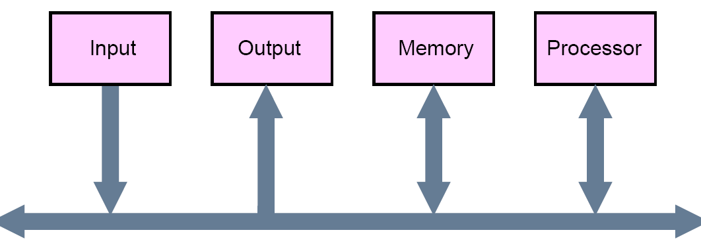
Bus Structures
A group of lines that serves a connecting path for several devices is called a bus
  In addition to the lines that carry the data, the bus must have lines for address and control purposes
  The simplest way to interconnect functional units is to use a single bus, as shown below

Slide 15
Drawbacks of the Single Bus Structure
The devices connected to a bus vary widely in their speed of operation
  Some devices are relatively slow, such as printer and keyboard
  Some devices are considerably fast, such as optical disks
  Memory and processor units operate are the fastest parts of a computer
Efficient transfer mechanism thus is needed to cope with this problem
  A common approach is to include buffer registers with the devices to hold the information during transfers
  An another approach is to use two-bus structure and an additional transfer mechanism
    A high-performance bus, a low-performance, and a bridge for transferring the data between the two buses. ARMA Bus belongs to this structure

Slide 16
History of Computer
The Mechanical Era
Electronic computers
        The VLSI Era

Slide 17
The Mechanical Era
    Babbage’s Difference Engine - Addition
    Analytical Engine- Four Operations (+, -, * , / )
Drawbacks
Computing speed is limited by the inertia of its moving parts
Transmission of digital information by mechanical means is quite unreliable

Slide 18
First Generation –Vacuum Tubes-1930s
ENIAC- Electronic Numerical Integrator and Computer
  1st general-purpose electronic computer
  Designed by John Mauchly and John Presper Eckert -University of Pennsylvania
EDVAC- Electronic Discrete variable Computer
  By von Neumann at the Princeton Institute for Advanced Studies
    Von Neumann was a consultant on the ENIAC project
  Stored program concept

Slide 19
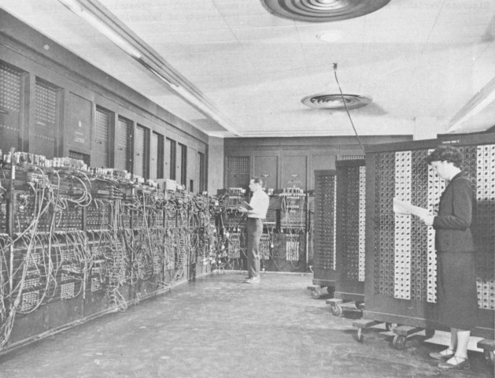
ENIAC
  Characteristics
    30 tons, 15000 square feet, 18000 vacuum tubes, 140 KW power dissipation
    Manually programmed by setting switches and plugging/unplugging cables
    5,000 additions per second

Slide 20
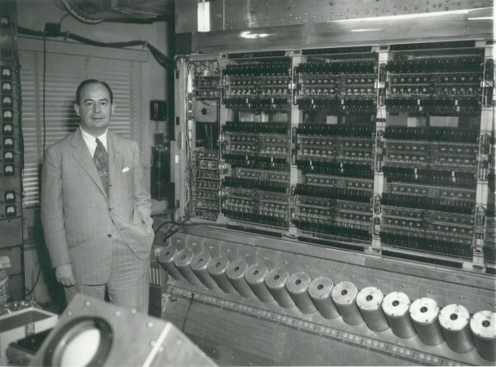
The Von Neumann Machine & IAS

Slide 21
Second Generation - Transistors
  Replaced vacuum tubes
  Smaller, cheaper, less heat dissipation
  Invented by William Shockley et al. in 1947 at Bell Labs
  Introduction of
      Higher level Programming Languages –FORTRAN,COBOL
      System Programs – Compilers (Higher –Machine)
      IO processors
      Floating Point Number formats

Slide 22
Third Generation - IC
Replaced Single self contained transistor –Discrete component
Began in 1965
Introduction of IC’s
Main Features -
        Software Compatible
        Common Operating system –OS/360
        Use same interface for attaching IO devices.
        Replaces the small and unstructured set of data registers with identical GPRs
    Eg IBM system 360

Slide 23
Fourth Generation –VLSI ERA-1970s
Complete processor to be fabricated on a single chip-Microprocessor
1971- Intel -4004 -First chip to contain all of the components of a CPU
  1971, Intel developed the first 4 bit microprocessor 4004
  1972, 8008 (8-bit)
  1974, 8080 (the first general-purpose microprocessor)
  1978, 8086 (16-bit)
  1982, 80286 (20 bit address, 16MB memory)
  1985, 80386 (32-bit)
  1989, 80486 the first pipelined processor, integrated FPU
  1993, Pentium (superscalar)
  1995, Pentium Pro (OOO, branch prediction)
  2000, Pentium 4 (superpipelining), Itanium (64-bit, VLIW)

Slide 24
IC Chips- A Look!!!!!!!
1962-Small Scale Integration -10-100 components per chip
1966-Medium Scale Integration – 100- 1000 Components per chip
1969- Large Scale Integration -1,000- 10,000 Components per chip
1975 –Very large Scale Integration – greater than 10,000
“The number of components per chip has doubled every year since 1962 “
Notes:
IC density:NO of the transistors contained in the chip

Slide 25
History of Computers
First Generation - Vacuum Tubes
Second Generation – Transistors
Third Generation – IC (SSI,MSI)
Fourth Generation – IC (VLSI)
Fifth - Artificial Intelligence ..etc.

Slide 26
Architecture & Organization
Architecture – Logical Aspect
Whether computer will have Multiply instruction
Organization –Physical Aspect
How the instruction to be implemented

Slide 27
IAS Computer
Developed by John Von Neumann in 1940 at Princeton University.
In IAS computer, IAS stands for Institute for Advanced Studies.

Slide 28

Structure of Von Neumann Machine
P.C. @V.Saritha

Slide 29
IAS -Cont
1000 x 40 bit words ( 1000 storage locations of 40 binary bits each)
  Binary number( both data and instructions are stored here)
Number Format:
  Each number is represented by a sign bit and a 39 bit value.
  Instruction Format
  20-bit instruction, 8-bit operation code (opcode)
  12-bit address
  .

Slide 30
Cont’
IAS – 21 Instructions
  Data Transfer
  Unconditional Branch Instruction
  Conditional Branch Instruction
  Arithmetic
  Address Modify Instruction

Slide 31
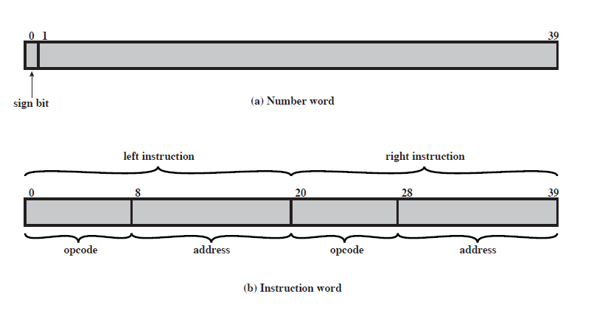
IAS Memory Formats

Slide 32
Expanded structure of IAS computer
Set of registers (storage in CPU)
  Memory Buffer Register (MBR)
    Contains a word to be stored in memory or it is used to receive a word from memory or from the I/O unit.
  Memory Address Register (MAR)
    Specifies the address in memory of the word to be written from or read into the MBR.
  Instruction Register (IR)
    Contains the 8 bit opcode instruction being executed.
  Instruction Buffer Register (IBR)
    Employed to hold temporarily the right hand instruction from a word in memory
  Program Counter (PC)
    Contains the address of the next instruction pair to be fetched from memory
  Accumulator (AC) & Multiplier Quotient (MQ)
    Employed to hold temporarily the right hand instruction from a word in memory. For eg. The result of multiplying two 40 bit numbers is an 80 bit number, the most significant 40 bits are stored in the AC and the least significant in the MQ.

Slide 33

Structure of IAS –detail

Slide 34











IAS Computer
AC
MQ
Input/output
Equipments
MAR←PC
MBR←M[MAR]
Arithmetic & Logic Circuits
IBR←MBR<20..39>
IBR←MBR<20..39>
IR←MBR<0..7>
IR←MBR<0..7>
MAR←MBR<8..19>
MAR←MBR<8..19>
MBR
MBR←M[MAR]
MBR←AC
AC←MBR
M[MAR}←MBR
IR←IBR<0..7>
IR←IBR<0..7>
MAR←IBR<8..19>
IBR
PC
Main Memory
MBR←M[MAR]
AC←AC + MBR
PC←PC+1
MAR←PC
IR
MBR←M[MAR]
MAR
Control
Circuits
P.C.@Saritha

Slide 35
References
William Stallings “Computer Organization and architecture”, Prentice Hall, 7th edition, 2006.

